Slide 1
Streaming Data Processing
By
Karthikeyan K R

Slide 2
Agenda
Project Statement
Project Overview
Project Requirements
Architecture Diagram
Implementation
Conclusion

Slide 3
Project Statement
Set up an end-to-end pipeline with Azure Data Factory for ingesting streaming data and Azure Databricks for real-time processing and analysis of the streaming data.

Slide 4
Project Overview
The primary goal of this project is to design and implement a robust end-to-end data pipeline using Azure Data Factory (ADF) and Azure Databricks to ingest, process, and analyse streaming data in real-time. The pipeline will enable the extraction of valuable insights from the streaming data source, providing a foundation for timely decision-making and actionable intelligence

Slide 5
Project Requirements
Azure Subscription
Data Source
Azure Event Hub
Azure Stream Analytics
Azure Data Lake
Azure Data Factory
Azure Databricks

Slide 6
Azure Subscription
You’re required to have an Azure Subscription to perform this project

Slide 7
Data Source
Created a python application, which fetches the weather data from the
google webpage

Slide 8
Azure Event Hub
Azure Event Hubs is a cloud-based messaging service provided by Microsoft Azure which enables large-scale, real-time event streaming for ingesting and processing data from various sources

Slide 9
Azure Stream Analytics
Azure Stream Analytics is a cloud-based service provided by Microsoft Azure that helps you analyse and gain insights from real-time data streams

Slide 10
Azure Data Lake
Azure Data Lake is like a massive storage space in the cloud where you can store and manage enormous amounts of data. It's designed to handle both large files and lots of small files

Slide 11
Azure Data Factory
Azure Data Factory is like a digital factory that helps you collect, transform, and move your data from one place to another in a smooth and organized way

Slide 12
Azure Databricks
Azure Databricks is like a super-smart workspace in the cloud where you can easily analyse and process large amounts of data using the power of Apache Spark.

Slide 13
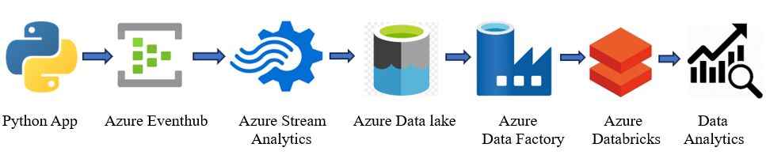
Architecture Diagram

Slide 14
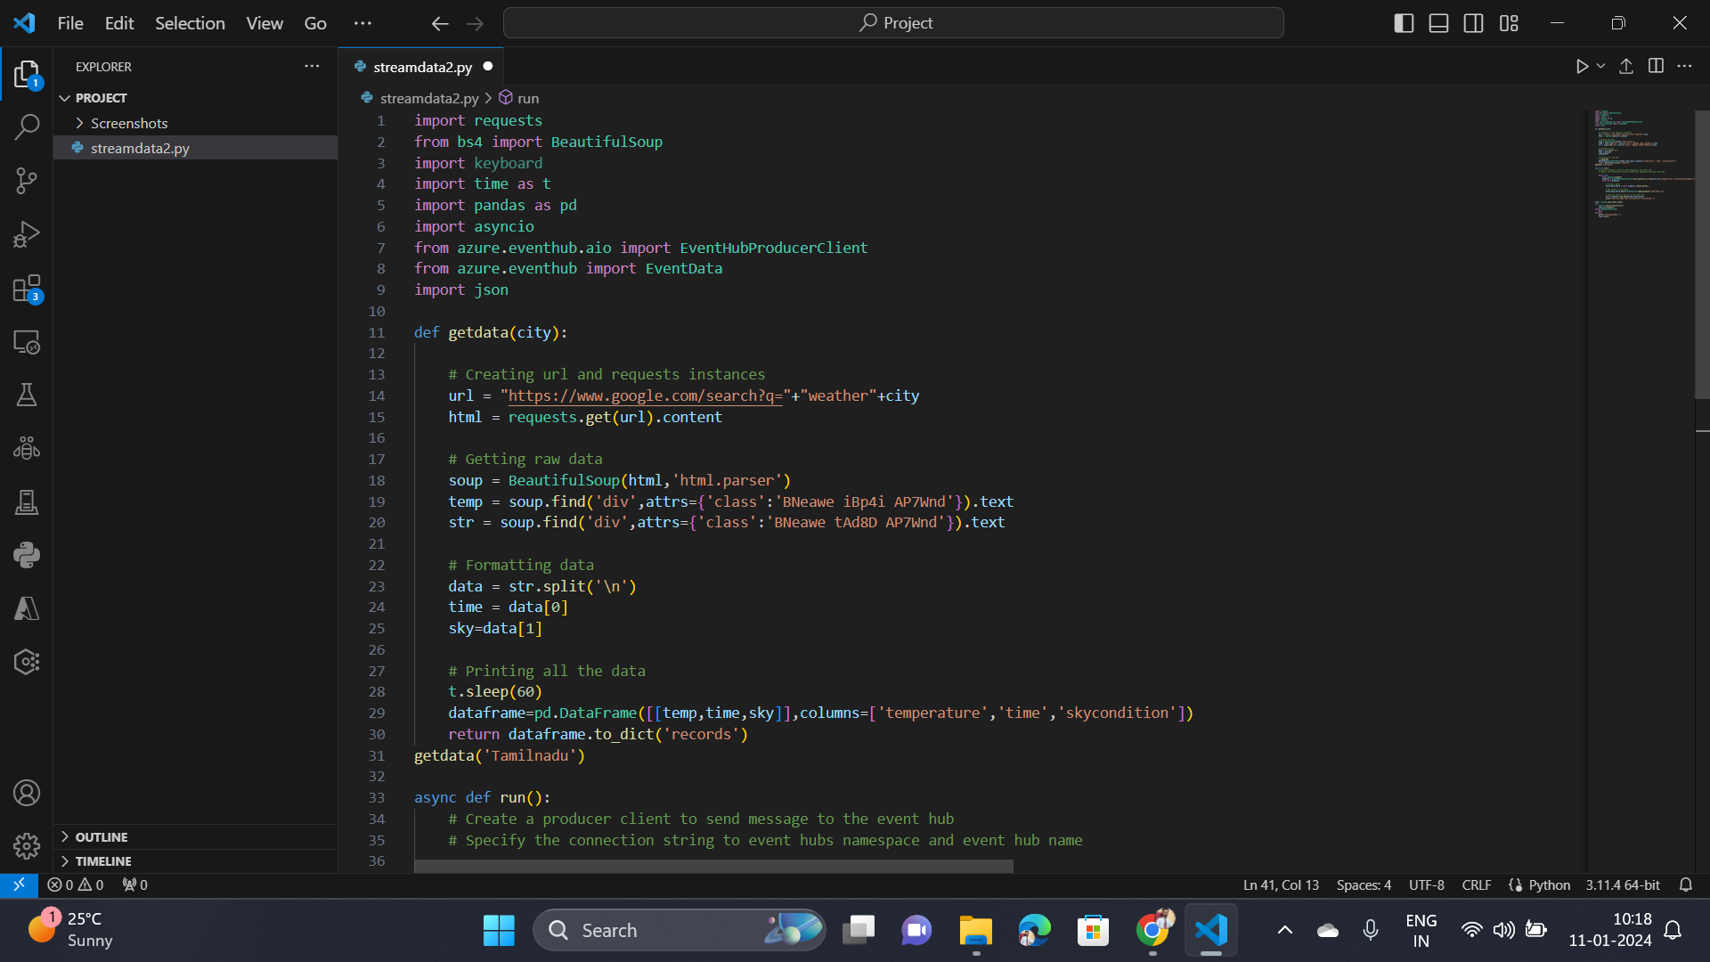
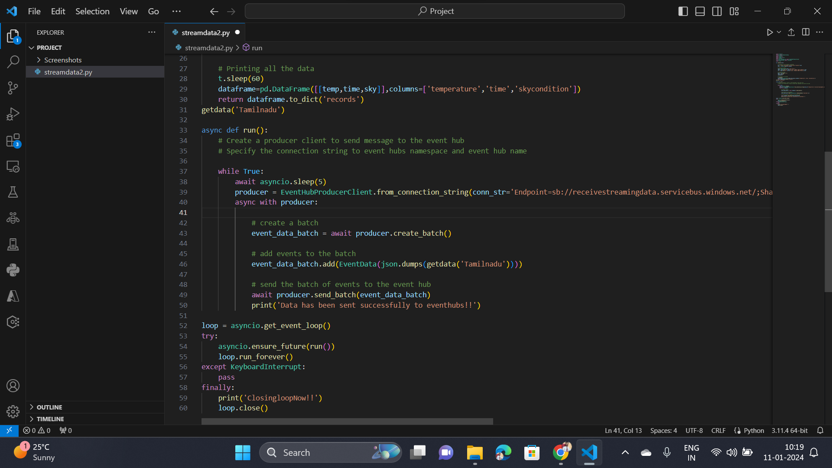
Implementation
Python Application

Slide 15
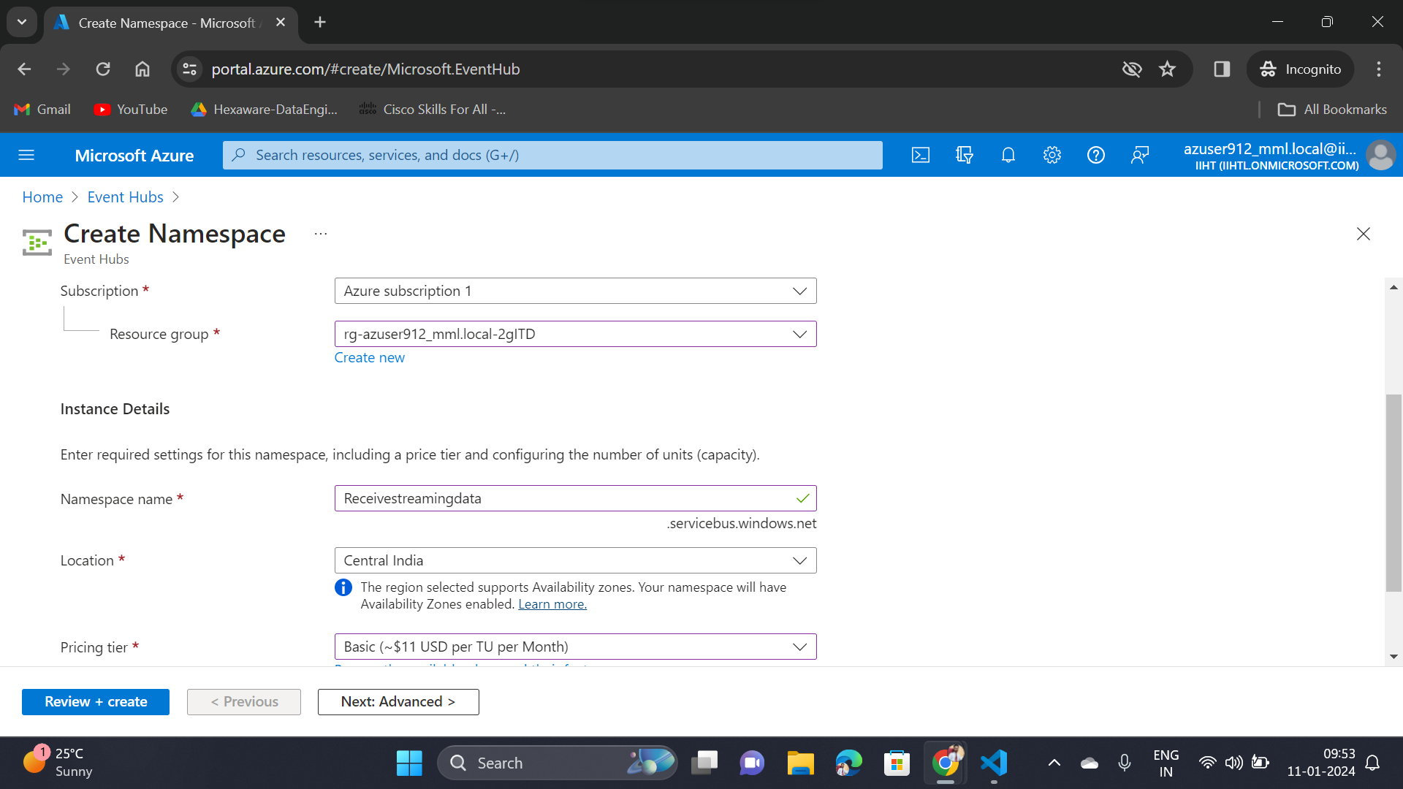
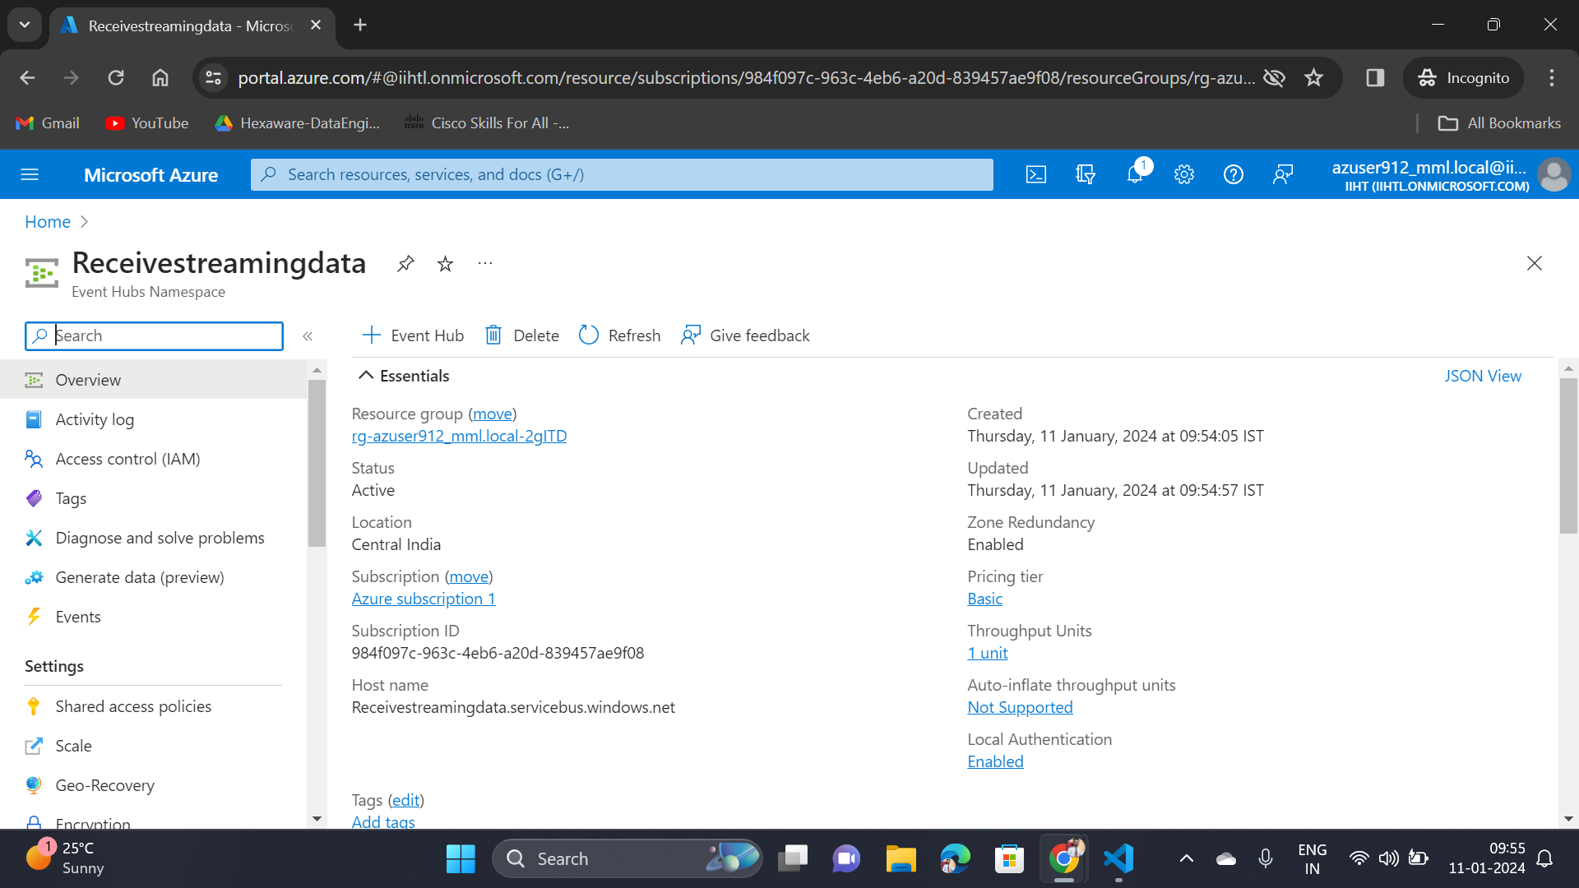
Event Hub Operations

Slide 16
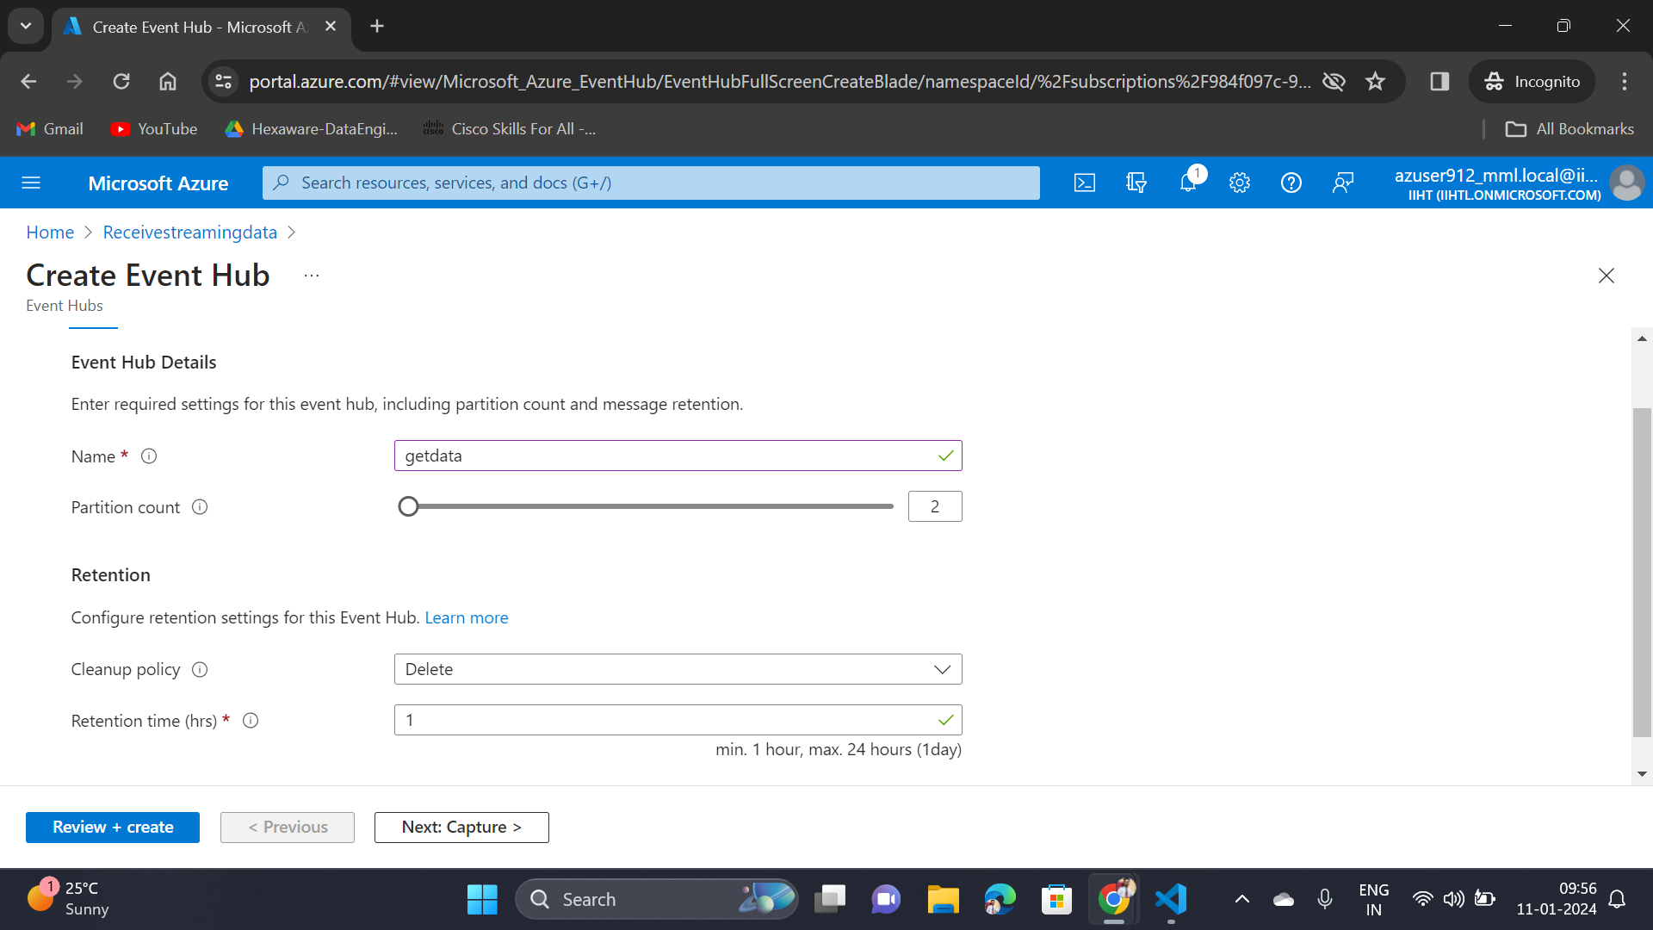
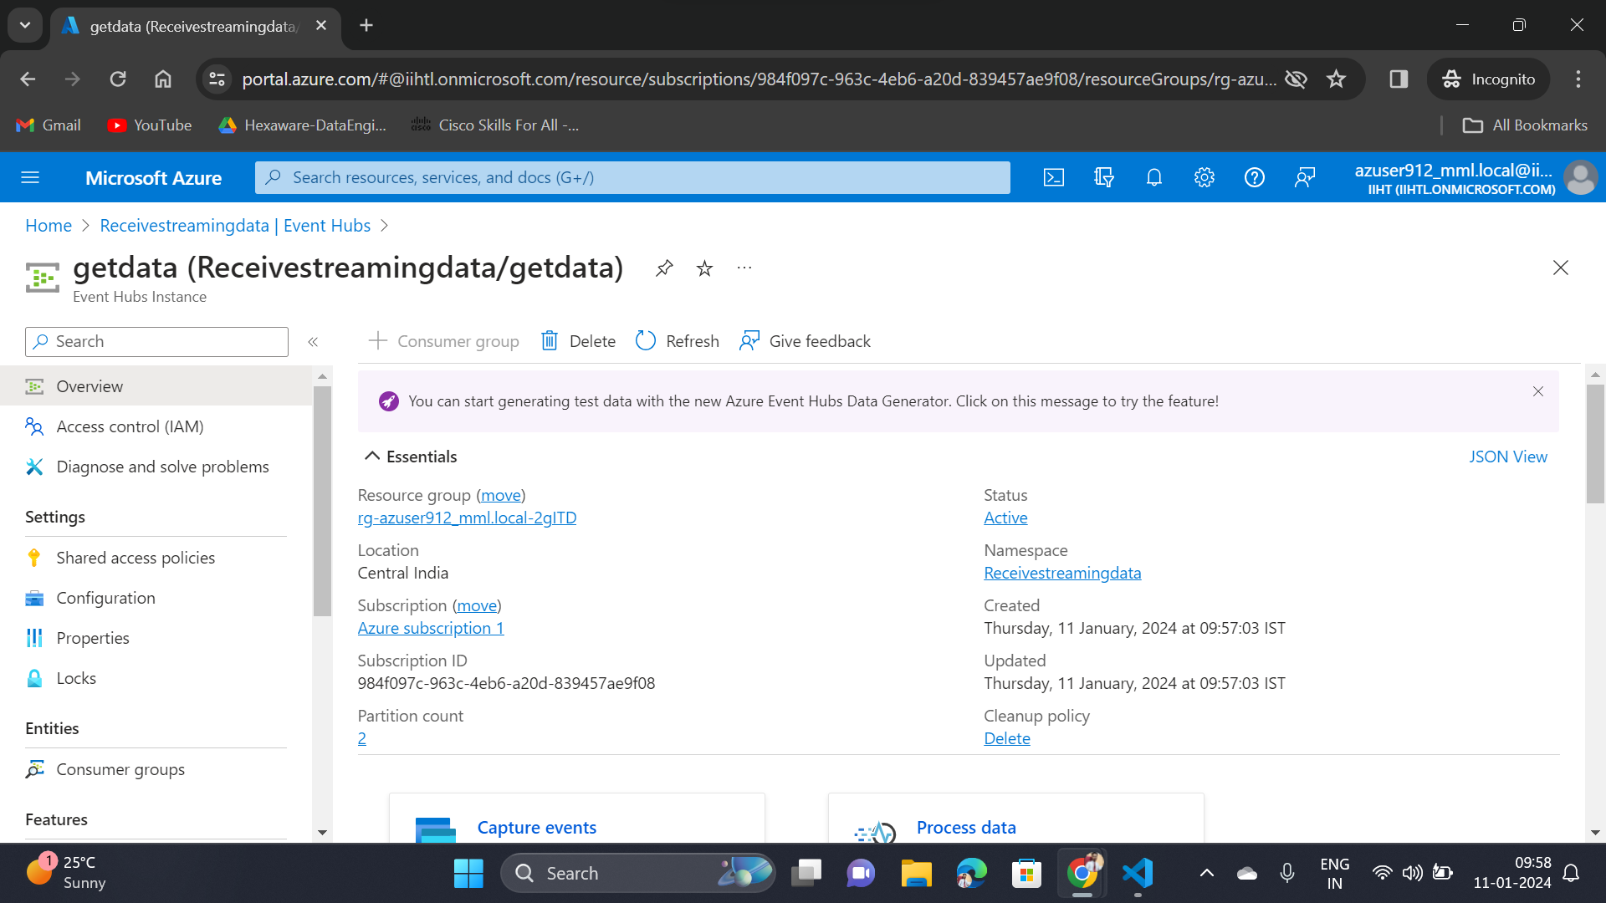

Slide 17
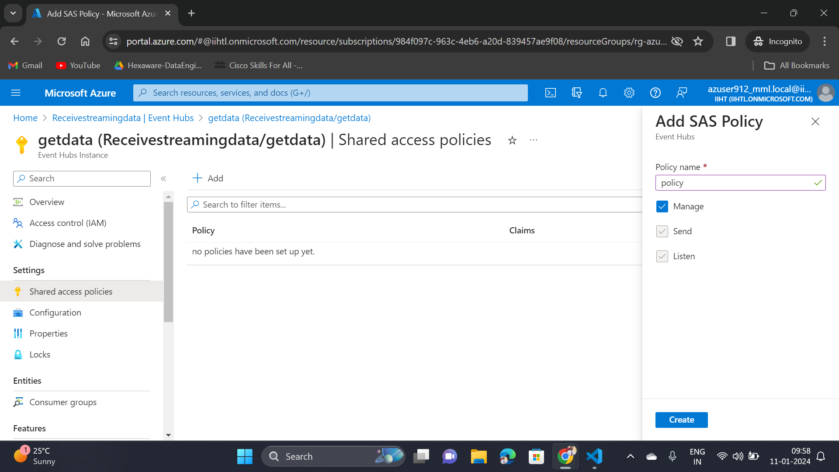
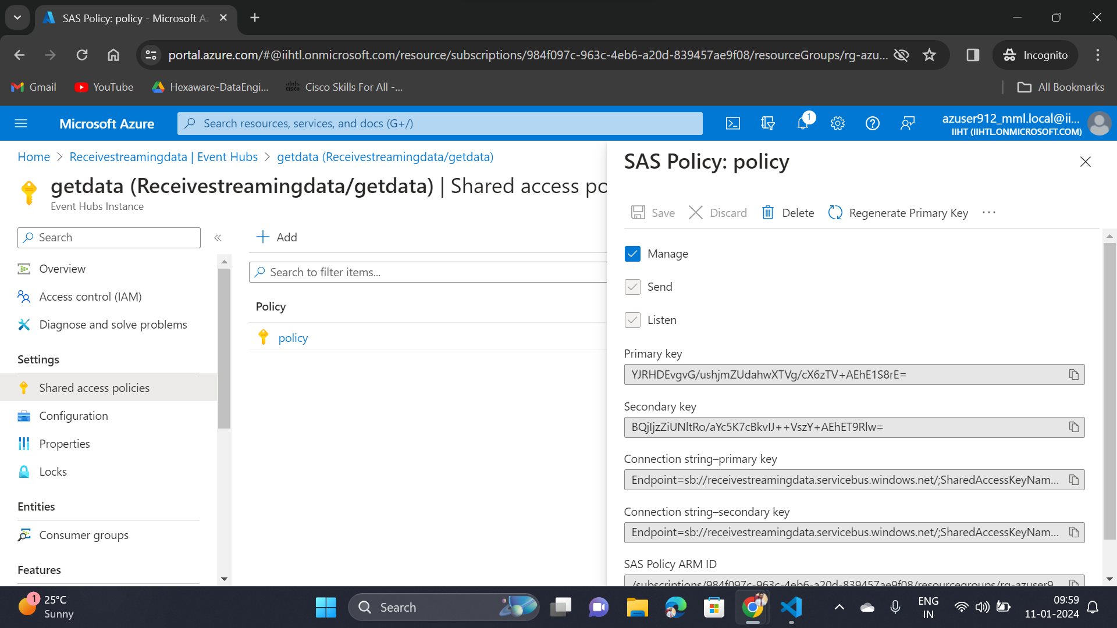

Slide 18
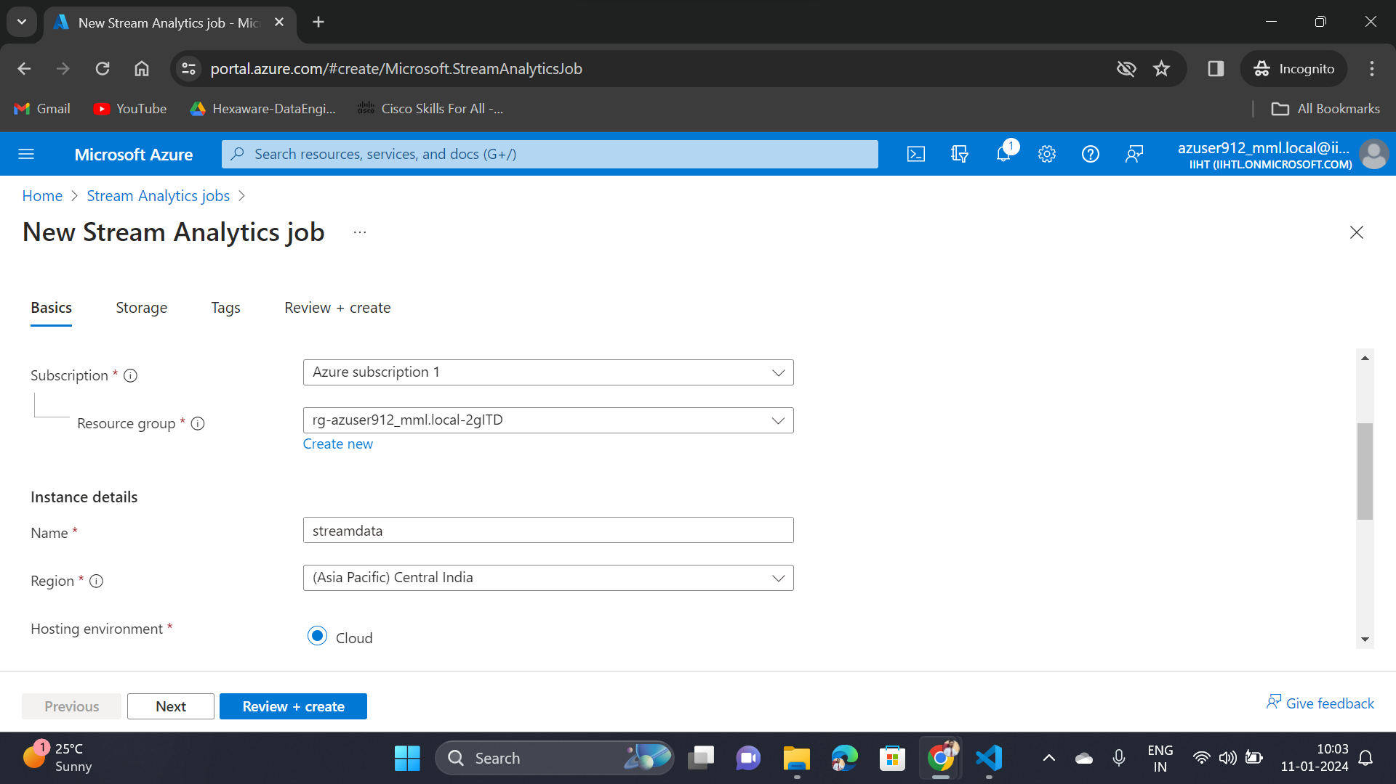
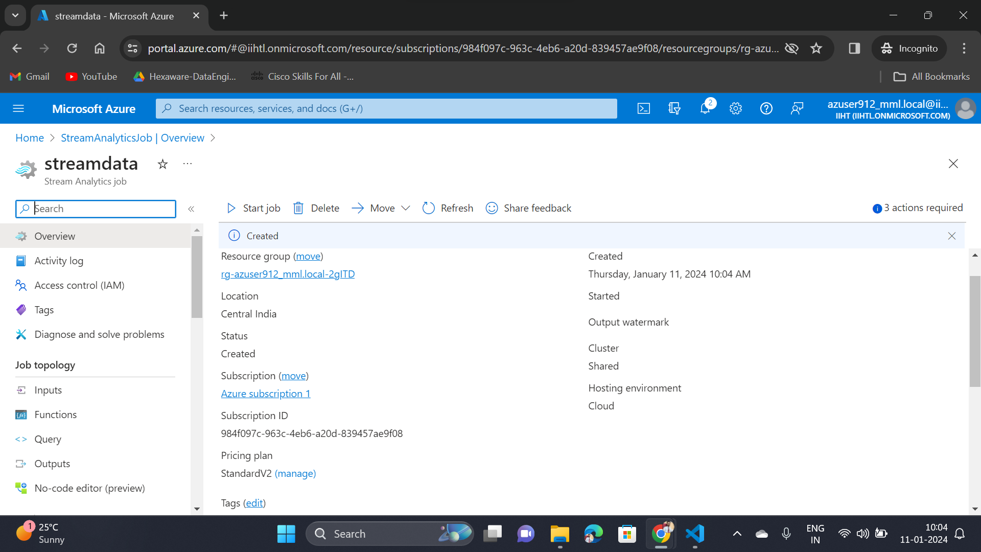
Azure Stream Analytics Job

Slide 19
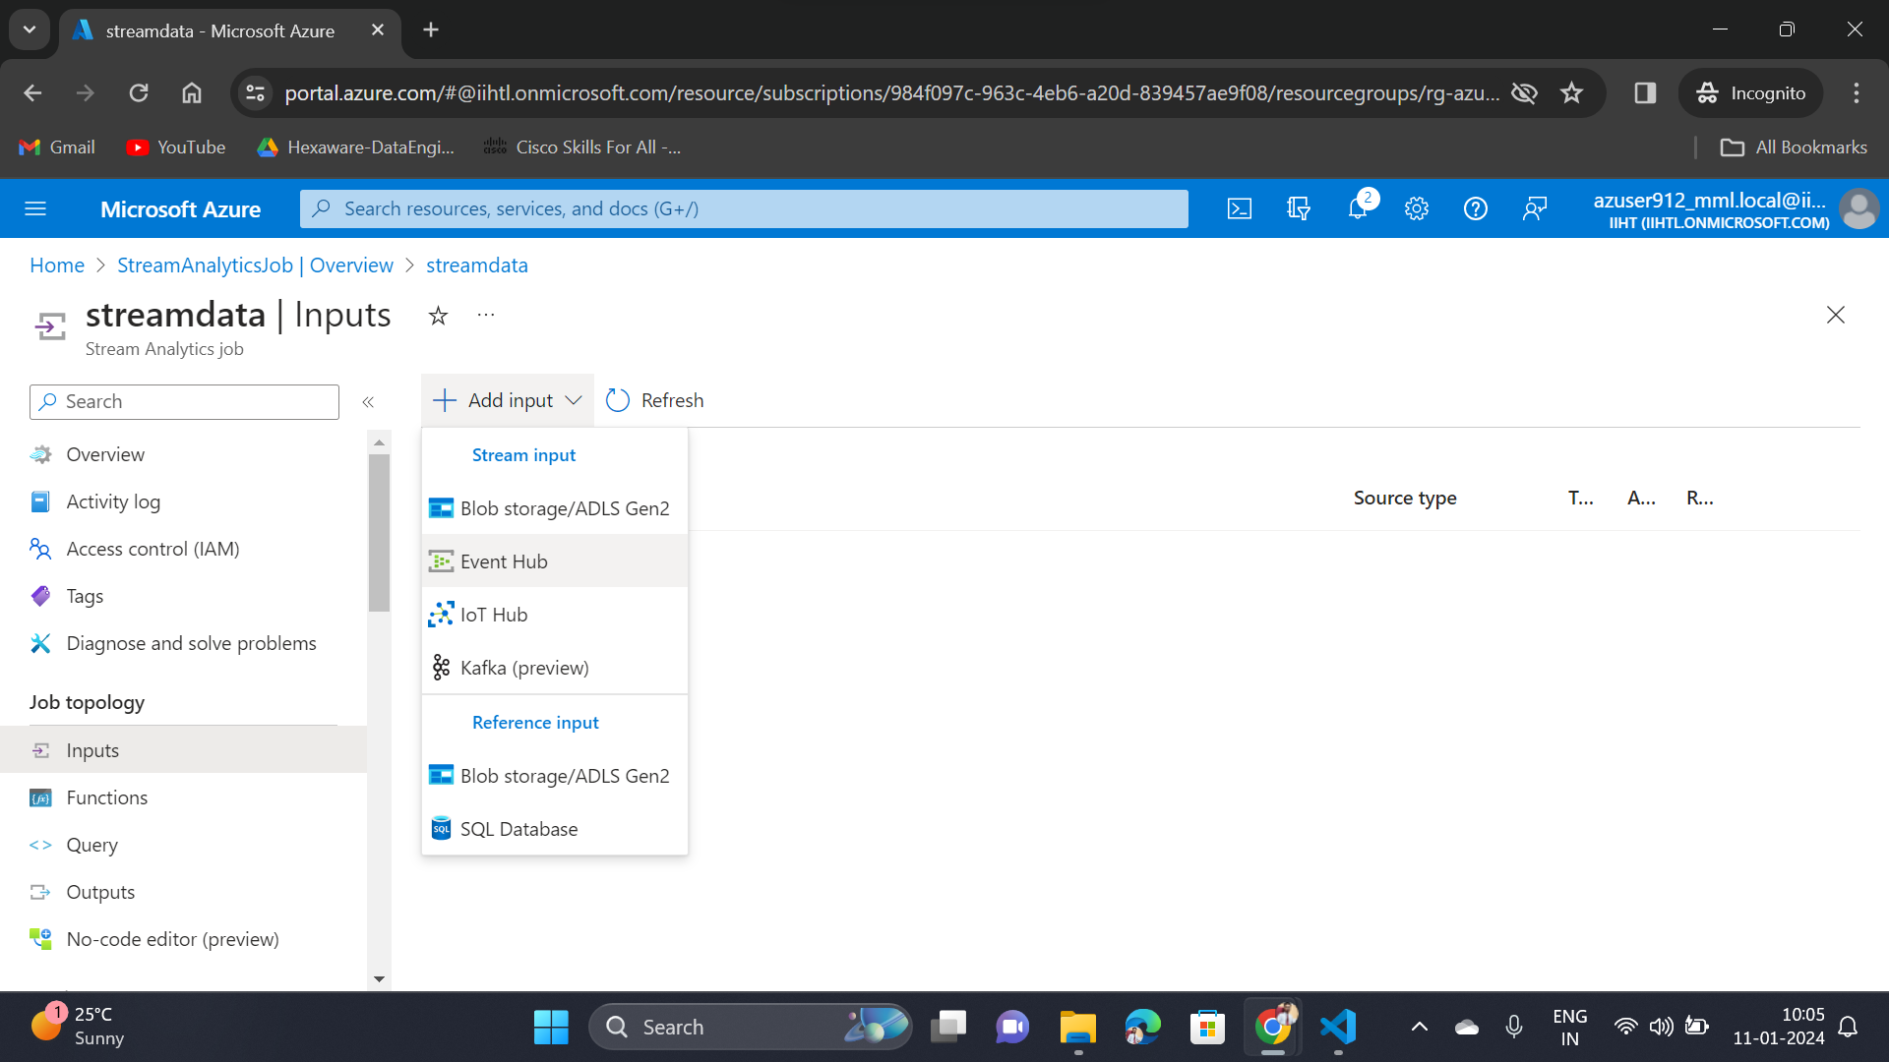
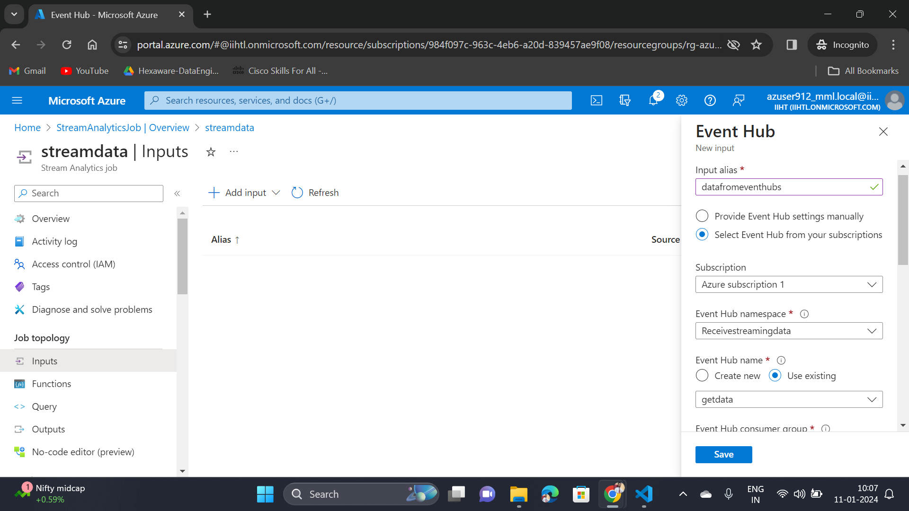

Slide 20
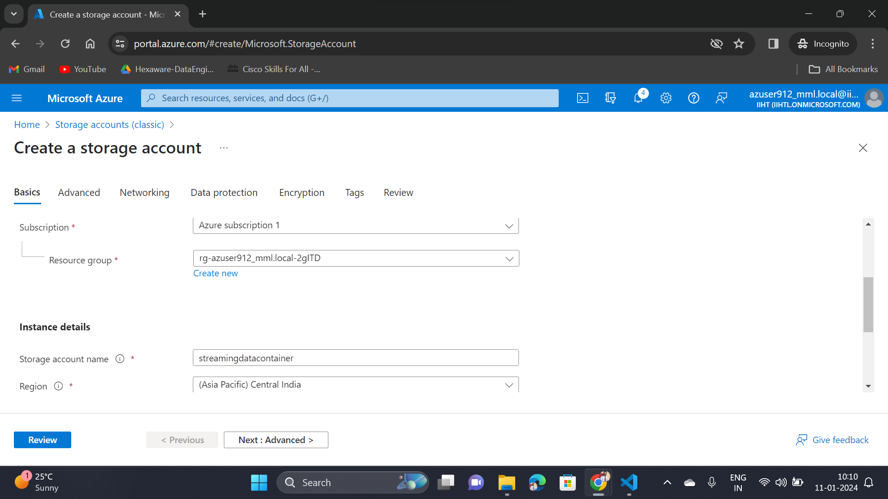
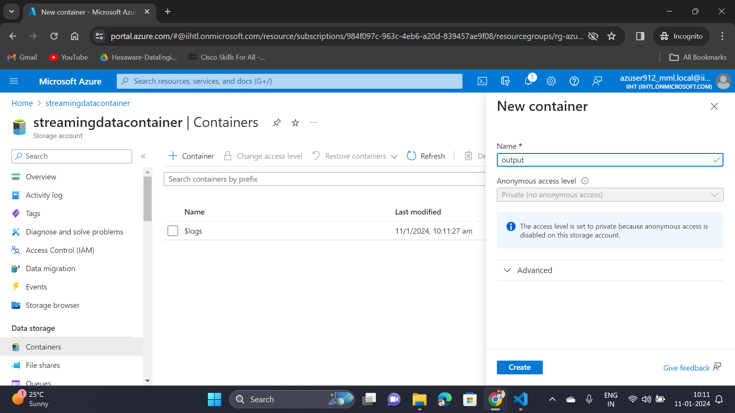
Storage Account Creation

Slide 21
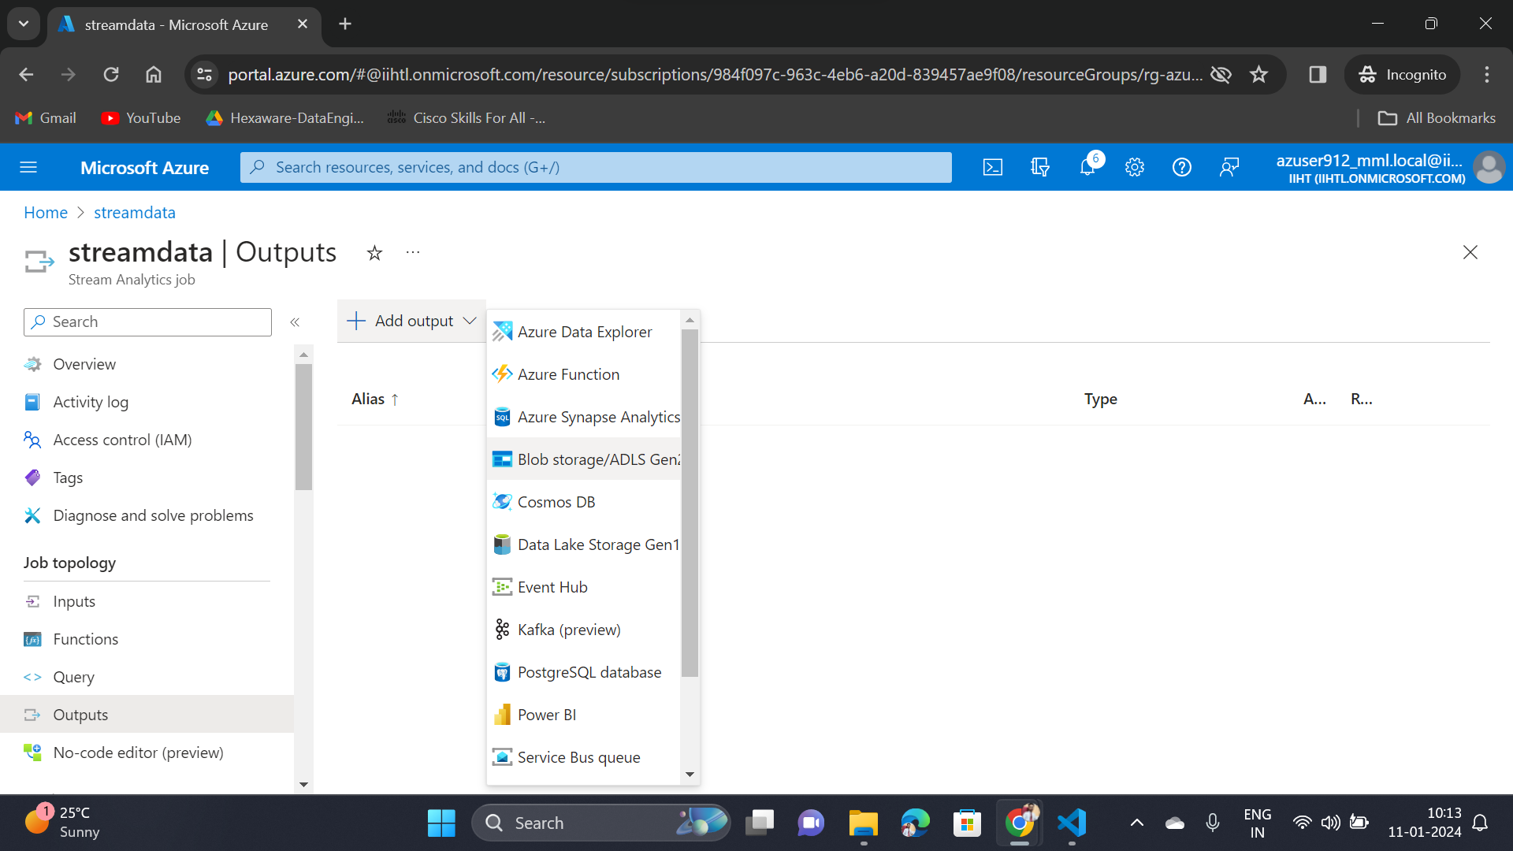
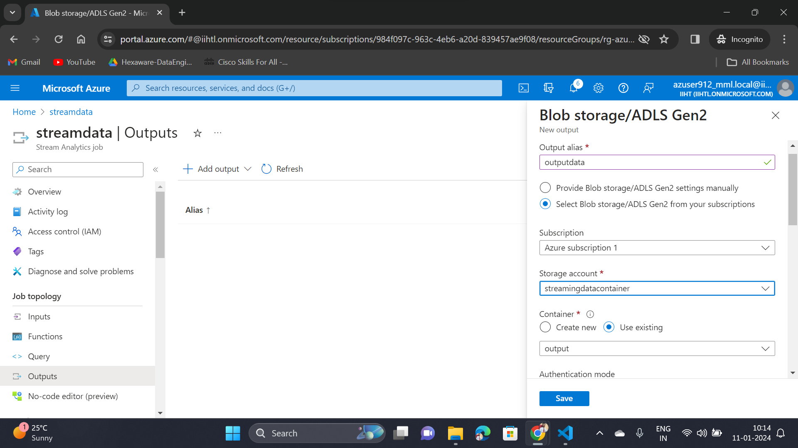
Output Service in Stream Analytics

Slide 22
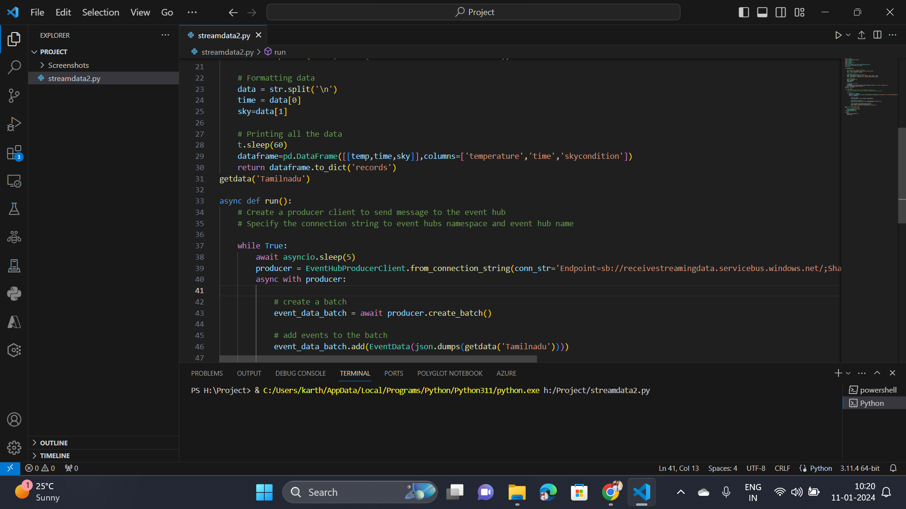
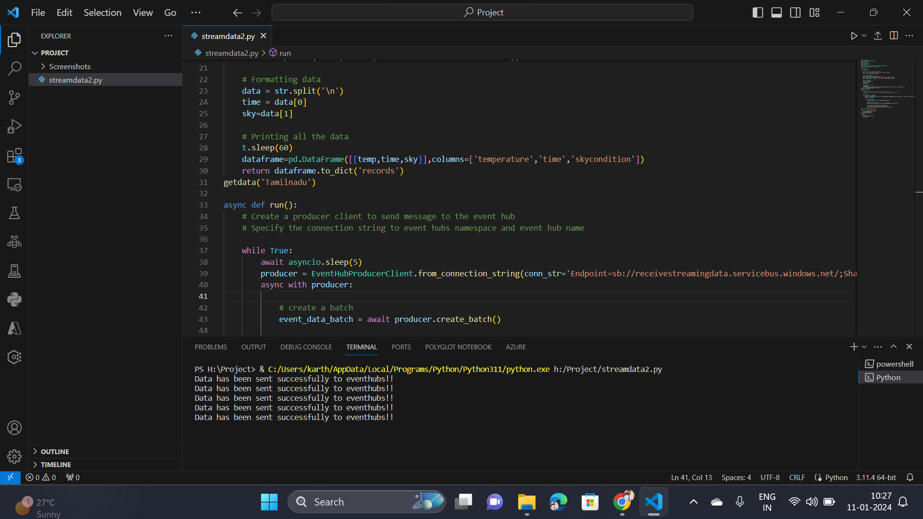
Running Python Application

Slide 23
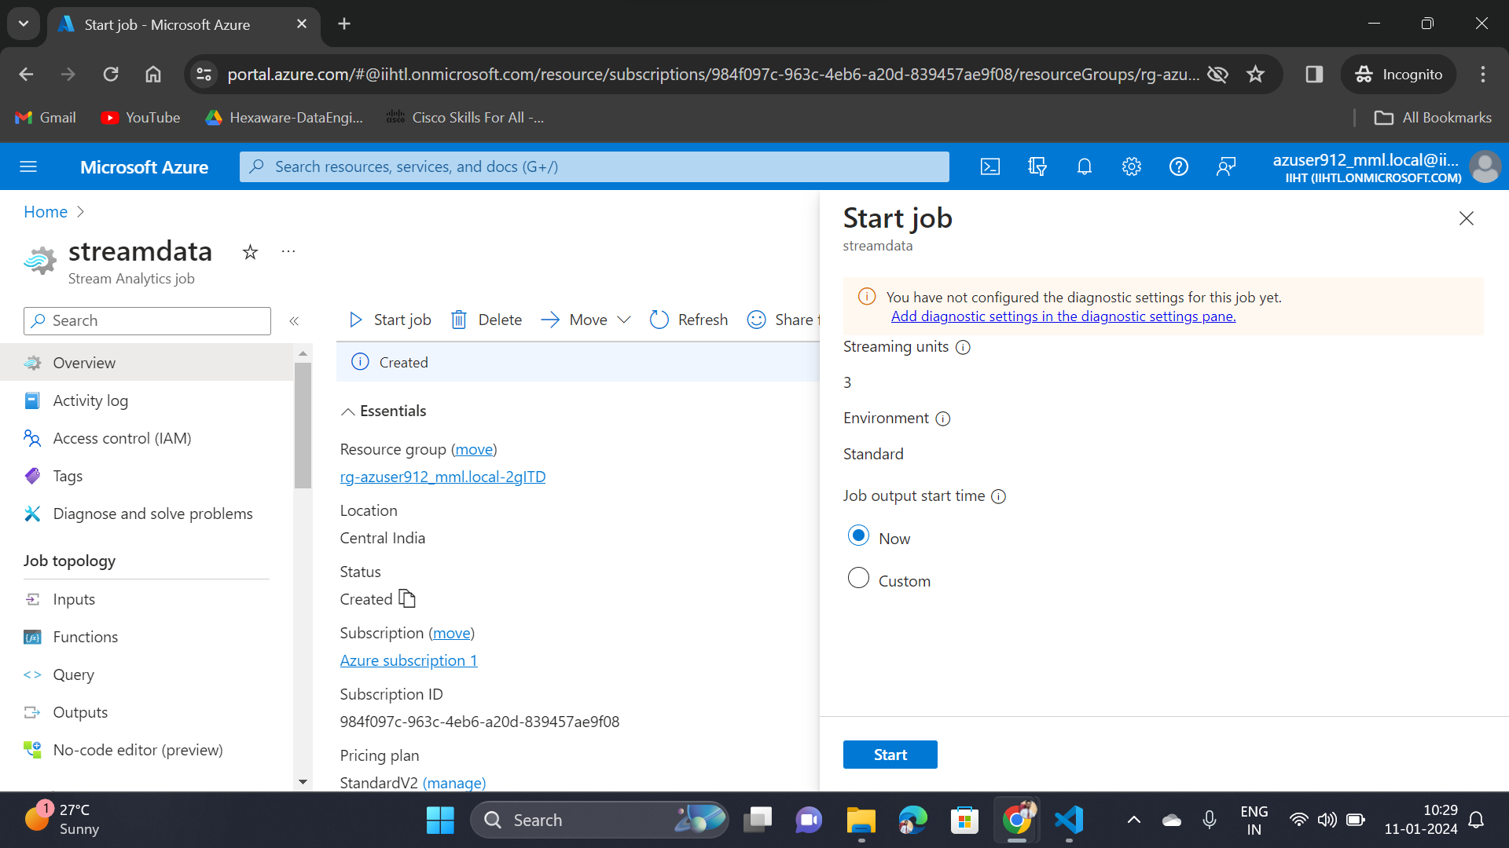
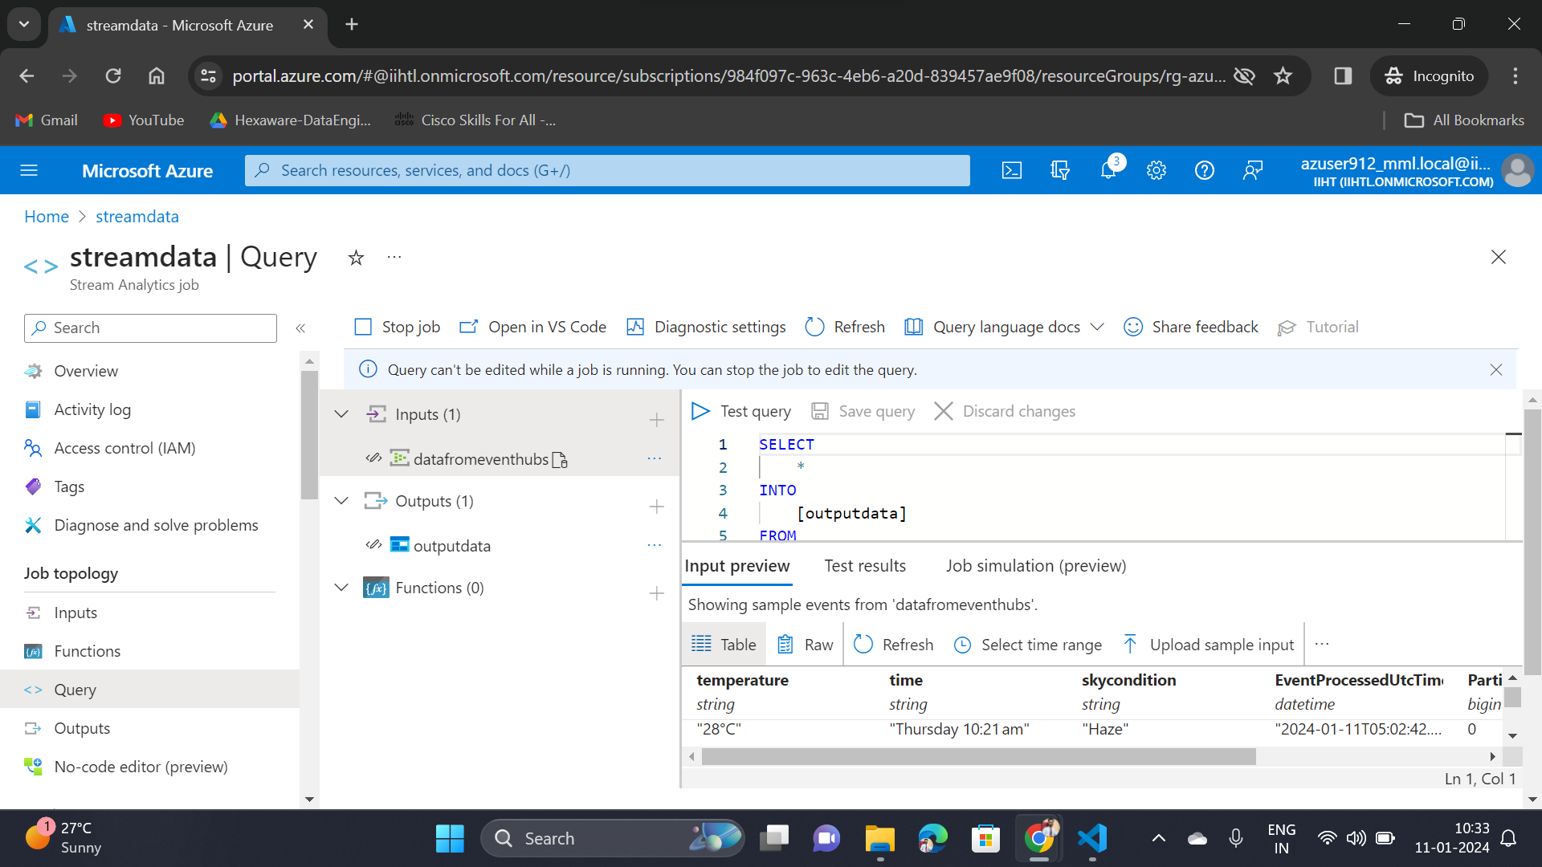
Starting and Running Stream Analytics Job

Slide 24
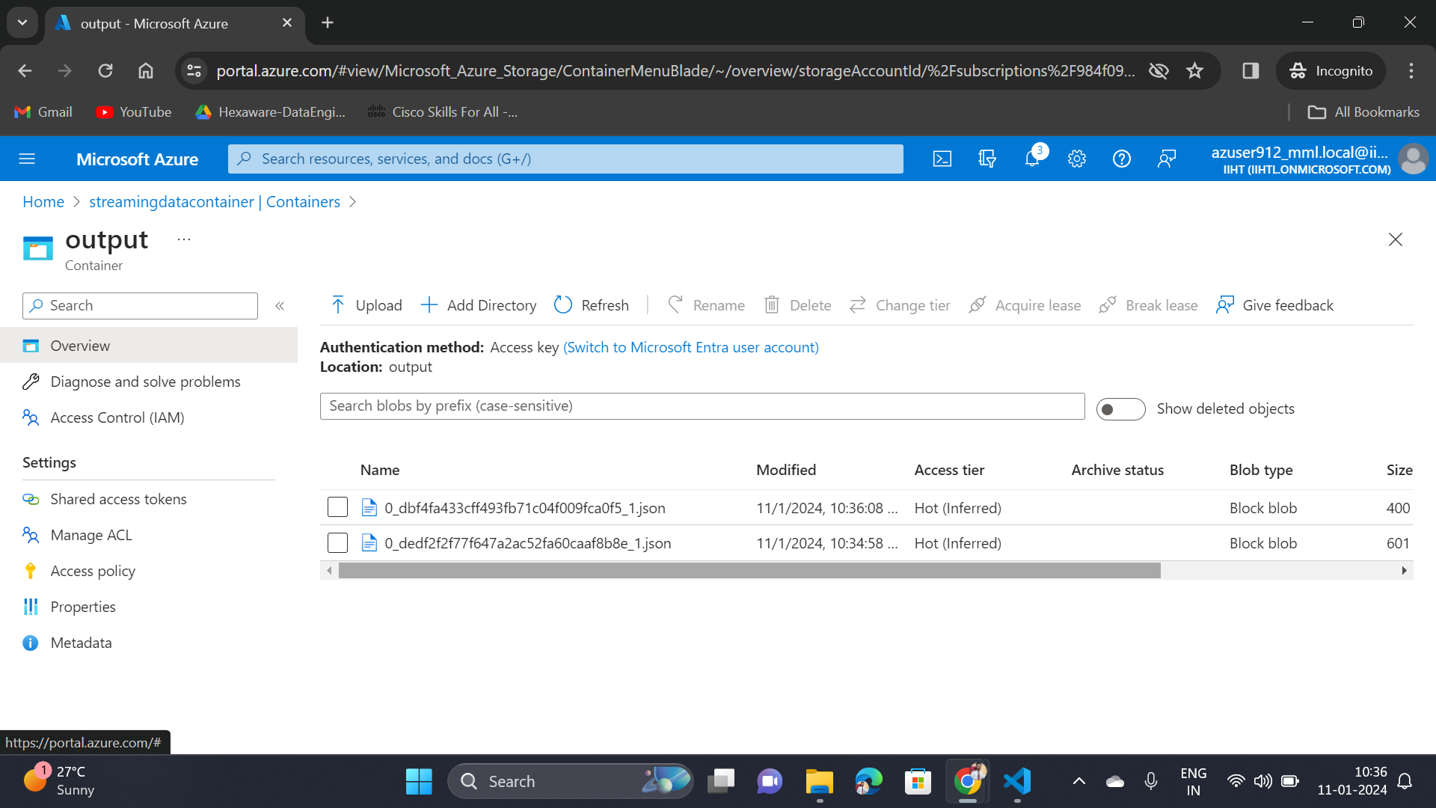
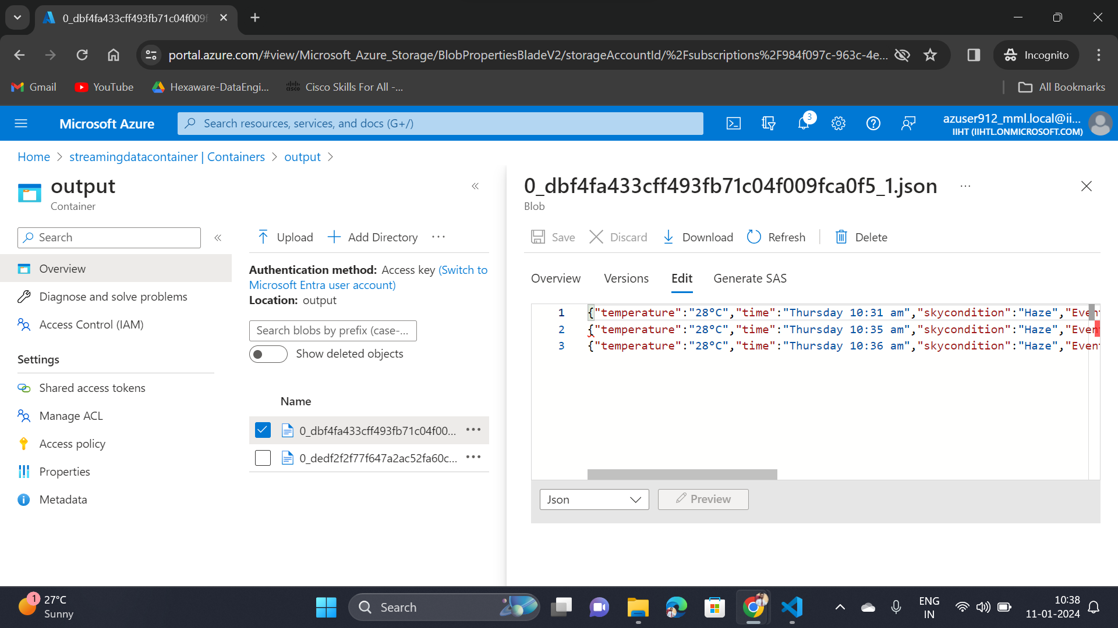
Azure Data Lake Storage

Slide 25
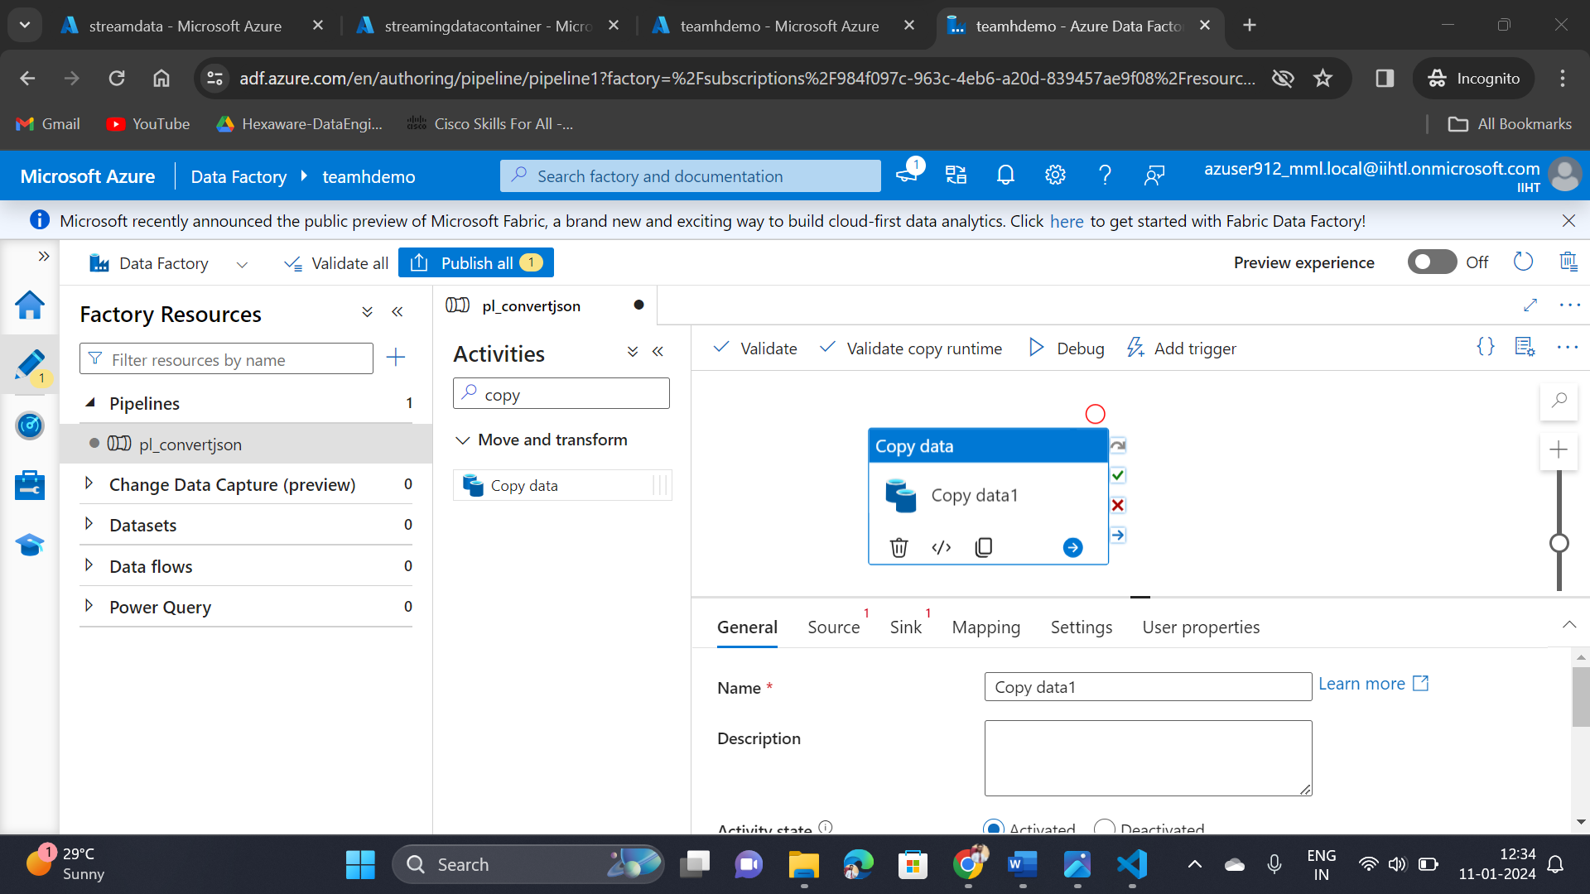
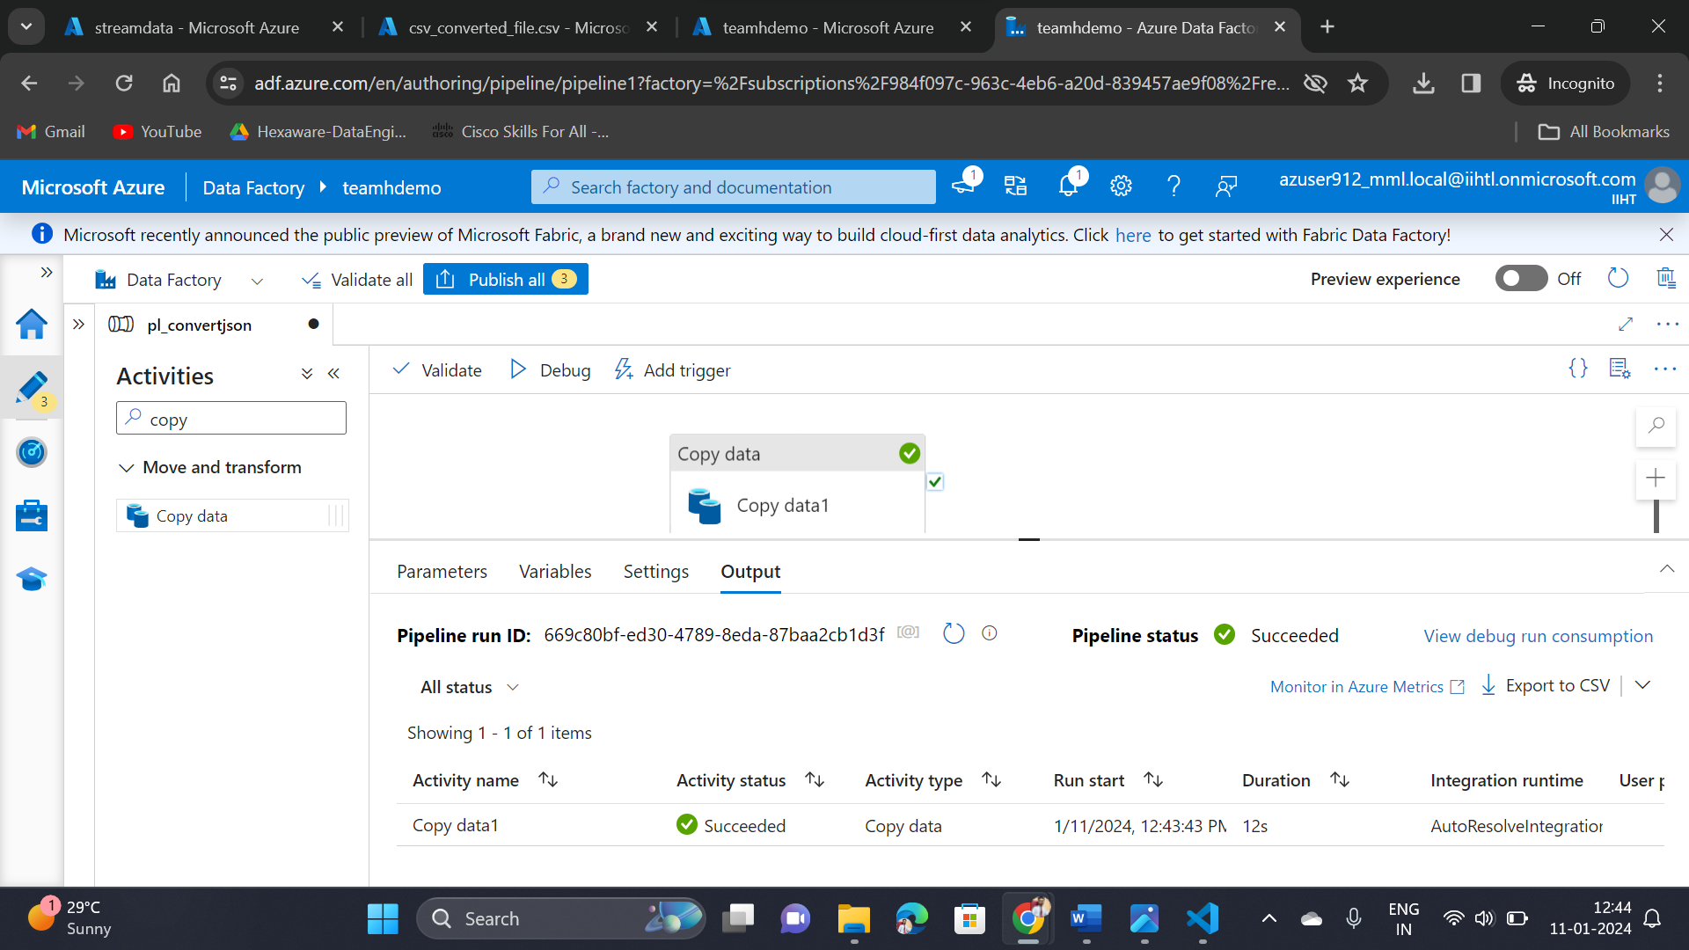
Azure Data Factory

Slide 26
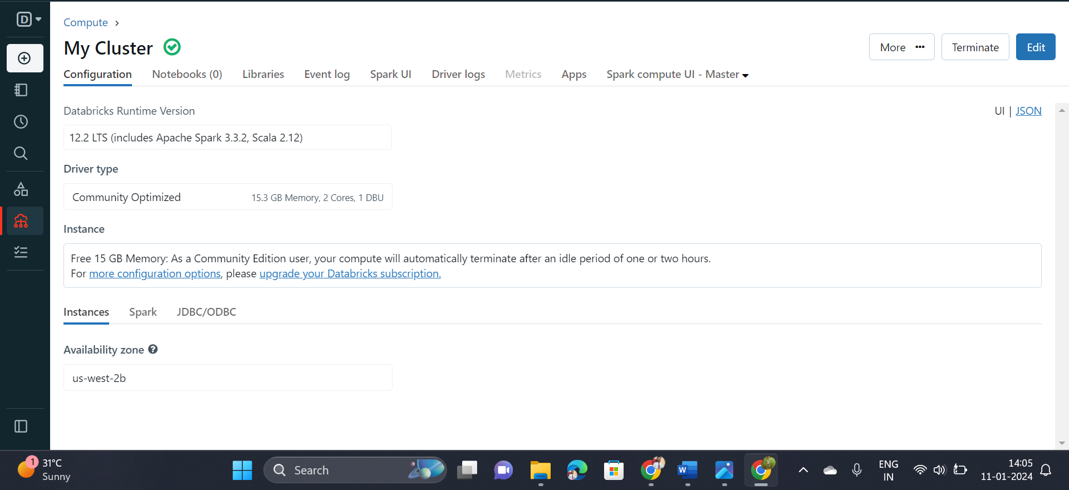
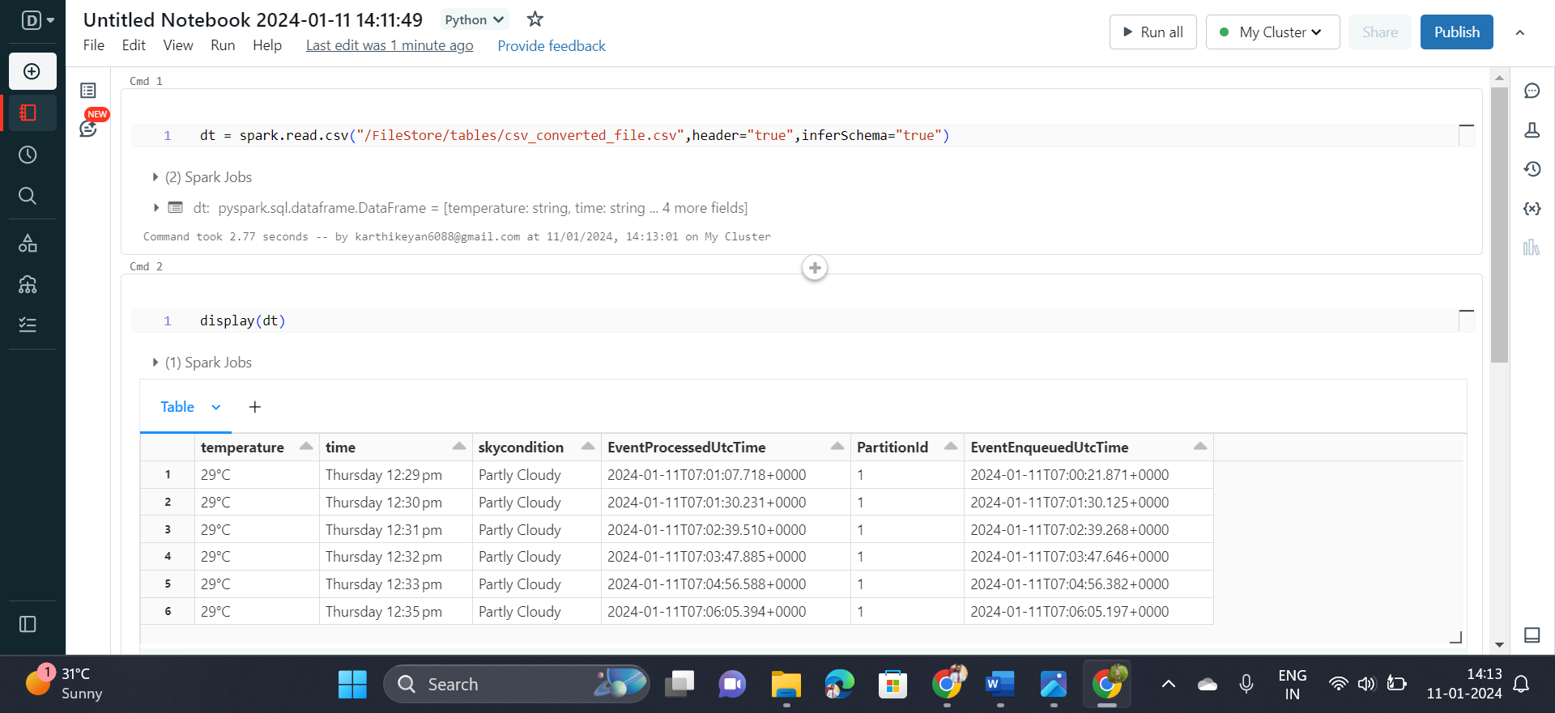
Azure Databricks

Slide 27
Conclusion
In conclusion, the project to set up an end-to-end pipeline with Azure Data Factory (ADF) for ingesting streaming data and Azure Databricks for real-time processing and analysis of the streaming data is a comprehensive solution for efficiently handling and deriving insights from continuous streams of information. The integration of these Azure services creates a powerful and scalable data processing ecosystem

Slide 28
Any Queries?

Slide 29
Thank You

